Slide 1
Module 1: Lesson 1 From Data to Value

Slide 2
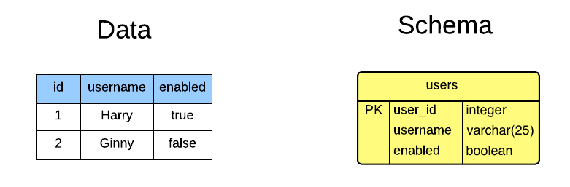
What is Data?
Facts or numbers, collected to be examined and considered and used to help decision-making
Information in an electronic form that can be stored and used by a computer
[Source: https://dictionary.cambridge.org/us/dictionary/english/data]

Slide 3
What is the Value of Data?
Data is the new oil
– Clive Humby
[Source: https://dictionary.cambridge.org/us/dictionary/english/data]

Slide 4
What is the Value of Data?
To test hypotheses and theories
To evaluate interventions
To identify patterns and trends
To inform policy and practice
To make predictions
To communicate findings.
Compare and contrast different groups or populations and their choices
To enhance business

Slide 5
Why is Data’s Value Challenging to Obtain?
Like oil, data is valuable, but if unrefined it cannot really be used
Oil has to be changed into gas, plastic, chemicals, etc. to create a valuable entity that drives profitable activity
So too, must data be broken down and analyzed for it to have value
Such data includes both useful and irrelevant or redundant information and must be processed to be meaningful
[Source: https://ana.blogs.com/maestros/2006/11/data_is_the_new.html]

Slide 6
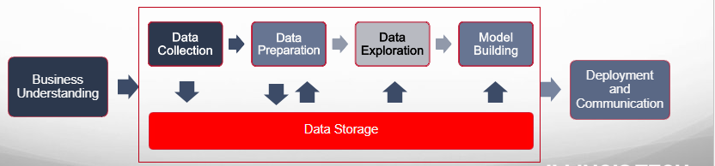
How Do We Process Data into Value?
Data science is an approach that combines practices from mathematics, statistics, artificial intelligence, and computer engineering to analyze data
A data science pipeline is a repeatable set of phases, stages or steps that are used to refine raw data into meaningful insights

Slide 7
How Do We Process Data into Value?
The value of a data science pipeline lies in its ability to systematically extract insights from data leading to informed decision-making
A data science pipeline is iterative, and stages may overlap or be revisited to allow for agility in data processing and analysis

Slide 8
How Do We Process Data into Value?
Business Understanding
Involves understanding the business goals of the data science project and identifying specific questions that the project is trying to answer.
Data Exploration
To gain an basic understanding of the data (including patterns and correlations) using variety of visualization tools and statistical method
Data Collection
Gather relevant data to supporting the business goals from various sources. This may include, APIs, external datasets, and more.
Model Building
Build and evaluate analytical models which capture insights to make predictions about or otherwise assess new data
Data Preparation
Clean and transform the data by handling missing values, dealing with outliers, standardizing data formats, and performing feature engineering
Deployment and Communication
Deploy a model into production and share the results and insights derived form data analysis with stakeholders

Slide 9
What are Challenges to this Process?
The traditional data science process has showcased the value of deriving insights from data to drive business decisions and improve outcomes.
Success stories in various industries have highlighted how data analysis can lead to better strategies, cost savings, and revenue generation.
As companies recognize the potential value of data, they have expanded their data collection efforts, resulting in the generation of vast amounts of data, contributing to the big data phenomenon
This growth in data is enabled by a number of factors, including the widespread adoption of the internet, the rise of e-commerce and e-health, the popularity of social media, and the increasing use of sensors and devices to collect data

Slide 10
Limitations of the Data Science Process For Handling Larger Datasets
Scalability
The traditional data science process is not well-suited for scaling up to handle large datasets. This is because it often involves loading an entire dataset into memory and performing complex computations on it.
Performance
Processing big data in a traditional way can result in performance bottlenecks. For example, running data analysis on a single machine can lead to slow processing times
Timeliness
The traditional data science process is designed for batch processing of data. This means that it is not well-suited for real-time data analysis, which is increasingly important in today's data-driven world.
Data Use
Traditional data science techniques may rely on data sampling and data reduction to make large datasets manageable. While this can speed up processing, it introduces the risk of losing valuable information.
Cost
Storing and managing big data can be prohibitively expensive in the traditional data science process. Traditional databases and storage solutions may not be cost-effective for handling large volumes of data.

